Slide 1
Poets
Gary Soto

Slide 2
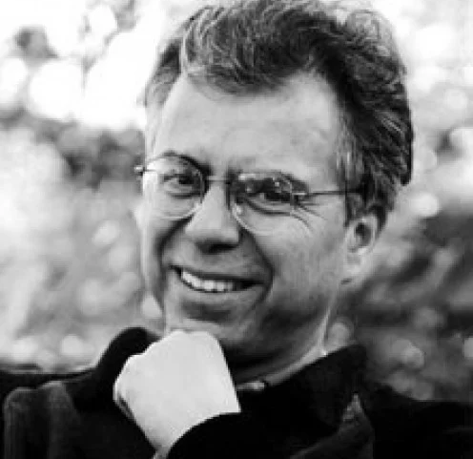
Gary Soto - born in Fresno, California April 12, 1952 -
His writings (poems, novels, short stories, plays) is rooted in the experiences a portrait of Mexican American life:
recreates the world of the barrio, (the urban Spanish-speaking neighborhood) where he was raised, bringing the sights, sounds and smells vividly to life within the pages of his books.

Slide 3
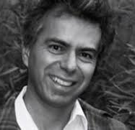
Poems
Soto’s poetry and novels focus on everyday experiences while evoking (brings to mind) the harsh forces that often shape life for Chicanos, including racism, poverty, and crime.
His writing transcends (exceeds) ethnic boundaries and allegiances.”

Slide 4
Author’s Style
Soto also uses literary devices & techniques.
Well known for his skill in using figurative language
Symbolism
Imagery as in the most popular poem, “Oranges”
This poem has no clear stanzas

Slide 5
Author’s Style cont’d
Notice this is a free verse poem, no rhymes
Reads like he’s retelling a story, a memory of his first date
Notice the symbolism of the oranges (warmth, color, confidence)
Notice the contrasts throughout the poem (old cars/new trees; bright orange/gray December)
Similes, metaphors

Slide 6
Oranges
The first time I walked
With a girl, I was twelve,
Cold, and weighted down
With two oranges in my jacket.
December. Frost cracking Imagery
Beneath my steps, my breath
Before me, then gone,
As I walked toward
Her house, the one whose
Porch light burned yellow (Hidden meaning? Why does porch light burn yellow
Night and day, in any weather. (night and day, in any weather)
She came out pulling
At her gloves, face bright
With rouge. I smiled,
Touched her shoulder, and led
Her down the street, across
A used car lot and a line Contrasts (used car lot, newly planted trees)
Of newly planted trees,
A dog barked at me, until
Until we were breathing
Before a drugstore. We
Entered, the tiny bell Symbolism (tiny bell, narrow aisle, perhaps wedding?)
Bringing a saleslady
Down a narrow aisle of goods.
I turned to the candies Simile (comparing candies and bleachers)
Tiered like bleachers,
And asked what she wanted -
Light in her eyes, a smile
Starting at the corners
Of her mouth. I fingered

Slide 7
Oranges cont’d
A nickel in my pocket,
And when she lifted a chocolate
That cost a dime, Imagery (apprehension)
I didn’t say anything.
I took the nickel from
My pocket, then an orange,
And set them quietly on
The counter. When I looked up,
The lady’s eyes met mine,
And held them, knowing
Very well what it was all
About.
Outside,
A few cars hissing past,
Fog hanging like old Simile & Imagery ( Fog and coats)
Coats between the trees.
I took my girl’s hand
In mine for two blocks,
Then released it to let
Her unwrap the chocolate.
I peeled my orange
That was so bright against What does this represent?
The gray of December Contrast between the two
That, from some distance,
Someone might have thought
I was making a fire in my hands

Slide 8
Literary Devices
Serve as a tool for writers to bring clarity and richness. With the help of literary devices, they not only give underlying meanings to their texts but also make their texts unique and appealing. (Literarydevices.net)

Slide 9
Poetry
Poetry is one method of letting your voice be heard.
Many types/forms of poetry
But how you use the literary devices and techniques will give your voice greater impact.
Write from the heart!

